Slide 1

CSS
The make up for webpages

Slide 2
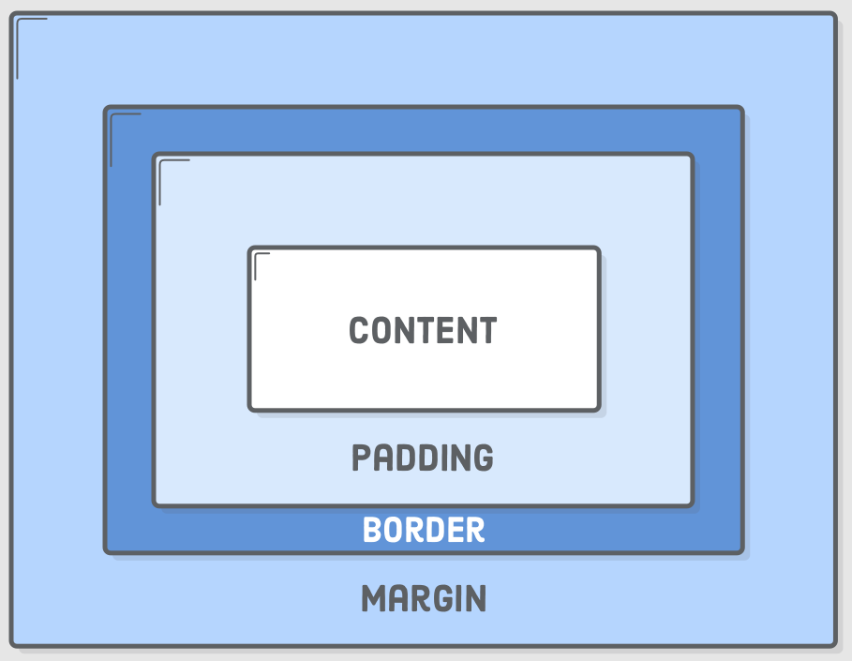
BOX Model
Everything is a box

Slide 3
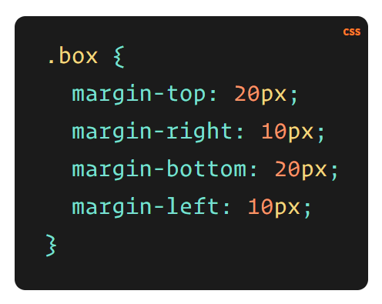
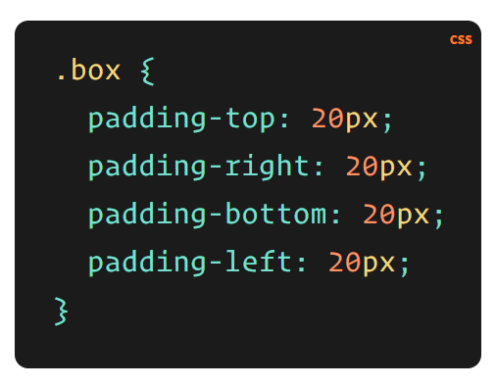
Margins, Padding, & Border
Border Properties are a little different than above.
3 parameters that define border – size, style and color

Slide 4
Positions
No Cascade here.
Static
Fixed
Relative
Absolute
Normal Flow of the document?

Slide 5
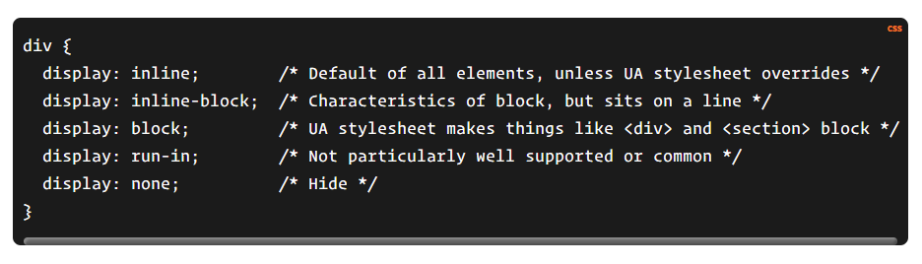
Display Properties
Inline (No height/width)
Block
Inline-block (hybrid of the above two)
None
Some others
Flex
Grid
…. etc

